Slide 1
CSS
MCNDHS
Ms. Eng

Slide 2
aim: How do we find complementing colors?
Do now:
Write down three hexadecimal colors.
Daily Grade:
On-time/attendance/not leaving the classroom: 25%
Cellphones: 25%
Notes:25%
Classwork/Homework: 25%

Slide 3

How to choose beautiful colors

Slide 4

analog colors

Slide 5

complementary colors

Slide 6

split complementary

Slide 7

triad colors

Slide 8
step 1: Choose a color
Choose any color on the color spectrum.
Write down the hex value

Slide 9

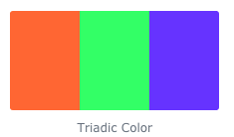
example 1:

Slide 10
activity
pick TWO colors.
Find the triadic complements for the two colors you chose.

